Slide 1
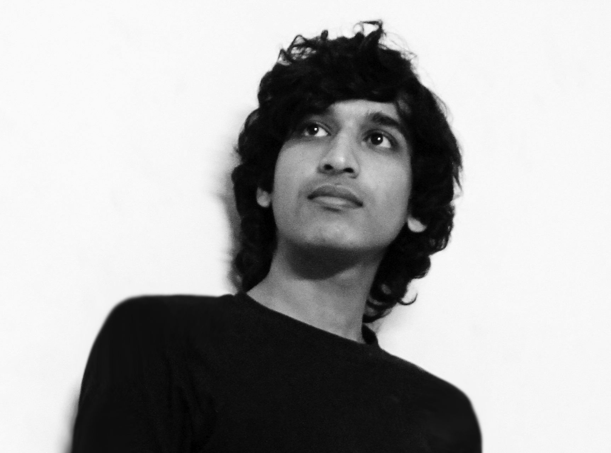
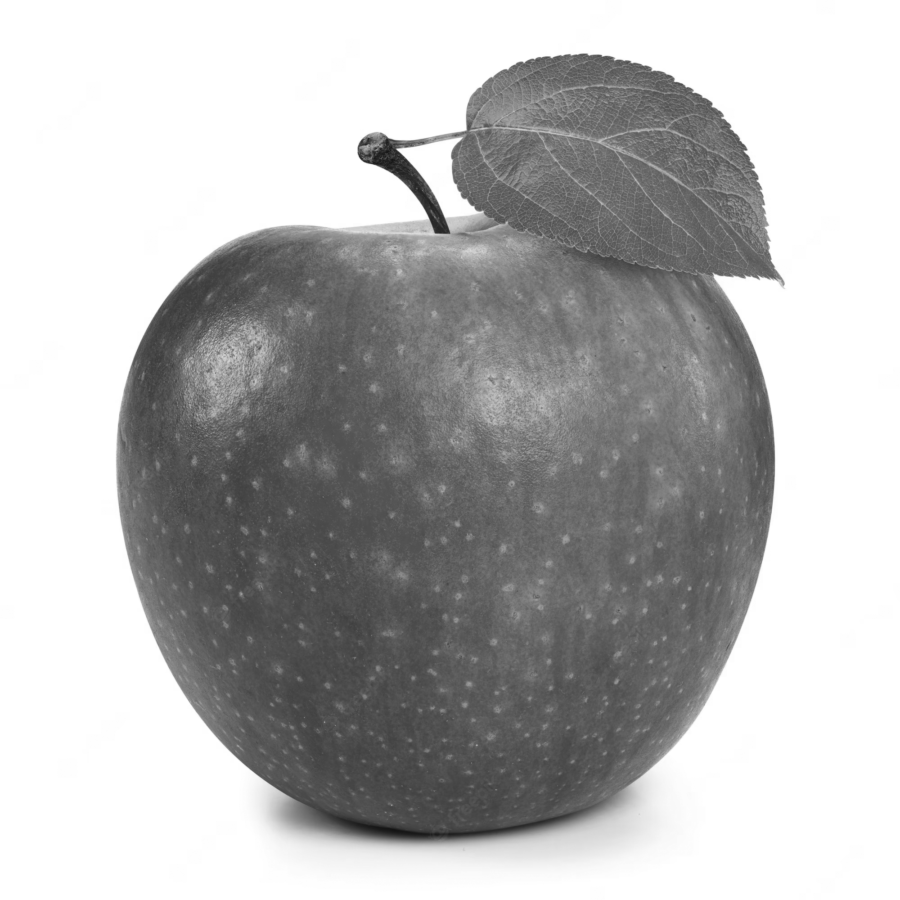
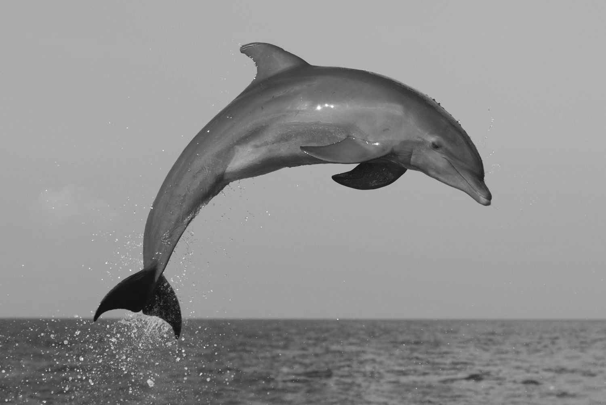
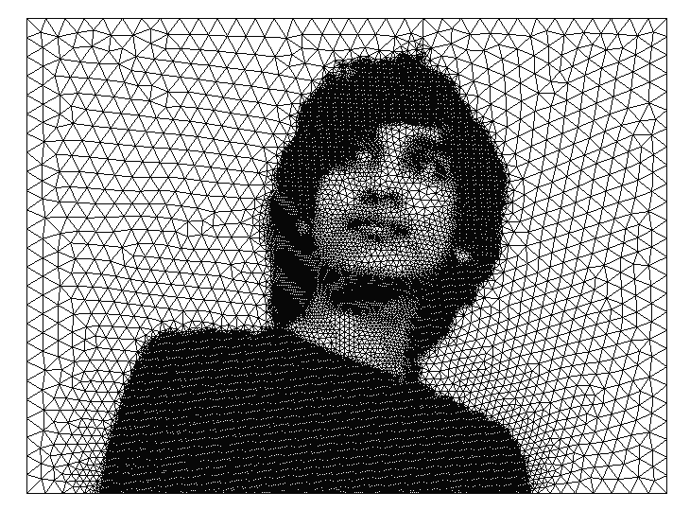
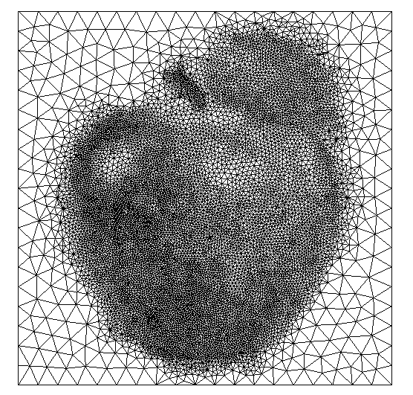
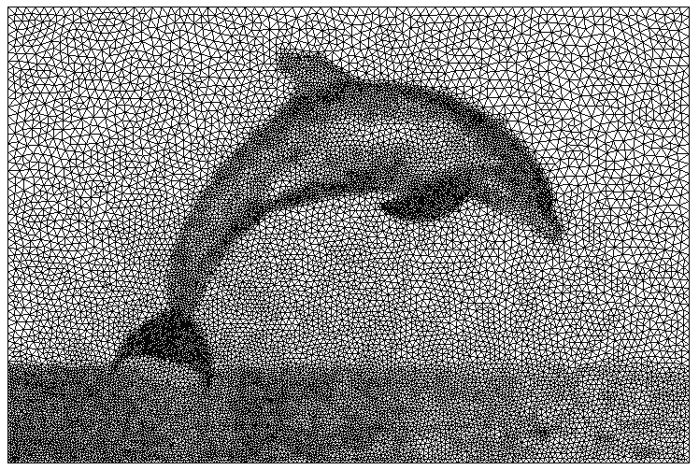
Picture to Mesh Conversion
Reference: https://diegomagela.github.io/2023/09/09/become-a-mesh
Tools: Gmsh, Python script
Before
Single Channel Picture
Gmsh Input
Modify the normalized pixel values
Characteristic lengths for the mesh
Apply the view as the current background mesh
2,209,280 Pixels
4,000,000 Pixels
1,506,000 Pixels
Build a geometry on top of the background mesh
After
Element size factor
Mesh Algorithm
Minimum element size
Post-process
Algorithm: Frontal
32,613 Nodes
64,890 Triangles
Algorithm: MeshAdapt
10,937 Nodes
21,796 Triangles
Algorithm: MeshAdapt
16,405 Nodes
32,429 Triangles
Output Mesh

